Slide 1
Nassau County Museum of Art
blue.
Instead of visiting NCMA with your class, we are bringing the Museum to you!
We have put together a series of art explorations using works from our current exhibition, which is all about the color blue. This one is about telling stories. We hope you enjoy it and can’t wait to see you in our galleries soon.
P.S. What’s YOUR favorite color?

Slide 2
blue.
storytelling
The following three images all have a story to tell. You are going to tell it!
Choose one of the images and write a story, poem, or song, about what’s happening. Consider the colors, the action, the mood, the setting and what you think might happen next.
You can use the sentence starters, or the poetry activity on the next slide or you do your own thing. There are only right answers!
Feel free to do it as a family-you could even try all 3!

Slide 3
Story Starter
Once upon a time…
Every day…
Until one morning…
And it seemed strange because….
But then suddenly…
And because of that…
And because of that…
No one could have predicted that…
And ever since then…
4 Line Poem
Line #1: Give the work a one word title
Line#2: 4 word action phrase (“Blowing in the wind”)
Line #3: Simile (“Like a glimmering, shining star”)
Line#4: Give the work a different one word title

Slide 4


Slide 5


Slide 6
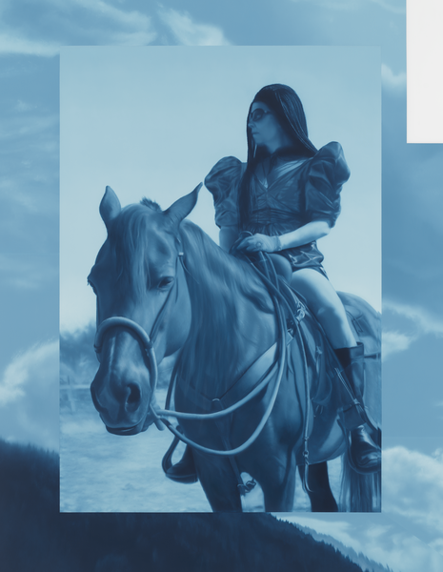

Slide 7
Object Labels
Christopher White
Huxley’s Guide to Switzerland, 2011
acrylic on canvas
36.5 x 27.5 inches
Courtesy of Edelman Arts
Antonio Santin
Toast to Ashes, 2020
215 x 150 cm
Courtesy of Marc Straus, New York
Andrew Sendor
Saturday’s hallucinations on December 2, 2018, 46 x 39 x 2 inches

